Slide 1

Green University Of Bangladesh
Title: Content Based Movie Recommendation System
Welcome To Our Project Presentation

Slide 2
Our Team Member
Md. Mahmudul Hasan
ID: 201015083
S.M. Mustafizur Rahman
ID: 212015052

Slide 3
Table of Content:
01
Introduction
02
Related works and Problem Statement
03
Objectives Of Project
04
Motivation
05
Methodologies Technique and Implementation
06
Tools & Technologies and Gantt Chart
07
Conclusion
08
References

Slide 4
Introduction
A movie recommendation system is an ML-based approach to filtering or predicting the users' film preferences based on their past choices and behavior.
The primary goal of movie recommendation systems is to filter and predict only those movies that a corresponding user is most likely want to watch.

Slide 5
Objectives of the Project
Improving the Accuracy of the recommendation system
Improve the Quality of the movie Recommendation system
Improving the Scalability.
Enhancing the user experience.

Slide 6
Motivation
Purpose of movie recommendation system aims to provide users with accurate movie recommendations. Usually basic recommendation system to make recommendations consider one of the following factors.
User preference known as content based Filtering or the preference of similar users known as collaborative filtering.

Slide 7
Related works
References | Methodology | Findings | Limitations | Dataset
Pradeep NK, Rao Mangalore KK, Rajpal B, Prasad N | Water Fall, Data Collection | Feature Importance | Limited Serendipity | MovieLens Dataset
K. Sparck Jones. "A statistical interpretation of term specificity and its application in retrieval | Data Analysis and Data Preprocessing | Text Data Processing | Dependency on Feature Quality | IMDb Datasets
G. Salton and M. J. McGill. "Introduction to modern information retrieval | Training and Testing the model, SimilarityCalculation | Similarity Metrics | Limited Diversity | Kaggle Datasets

Slide 8
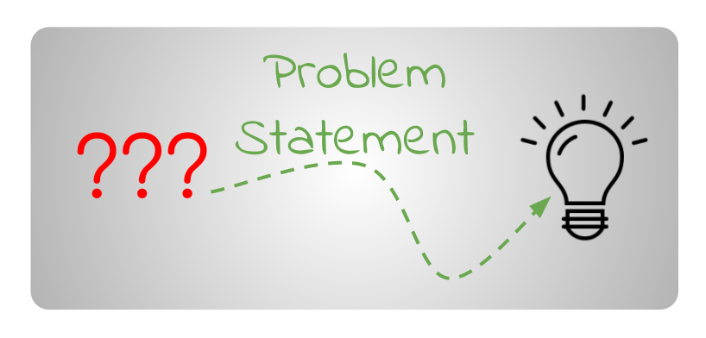
Problem Statement
The goal of the project is to recommend a movie to the user.
Providing related content out of relevant and irrelevant collection of items to users of online service providers.

Slide 9
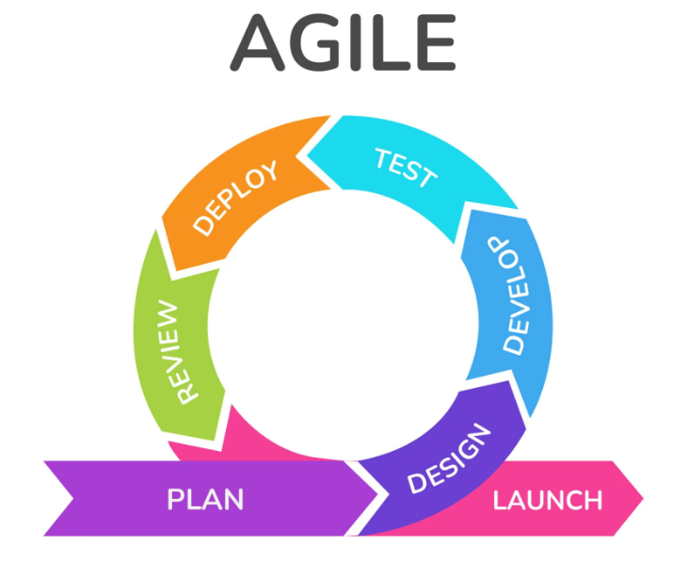
Methodologies Technique
Water Fall Development methodology is one of the best software development approaches.
1. Collecting the data sets: Collecting all the required data set from Kaggle web site. In this project we require movie.csv.
2. Data Analysis: make sure that that the collected data sets are correct and analysing the data in the csv files. i.e. checking whether all the column Felds are present in the data sets.
3. Algorithms: in our project we have only one algorithms one is cosine similarity used to build the machine learning recommendation model.

Slide 10
System Architecture
User
Movies
Search Movies
Content Based Filter
Optimal Result

Slide 11
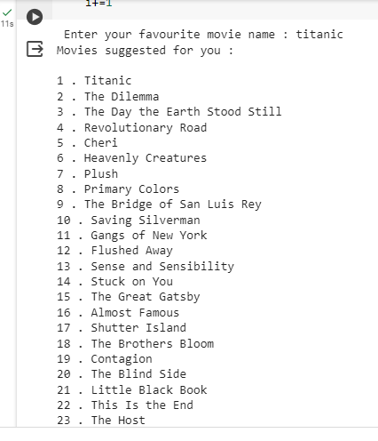
Implementation

Slide 12
Tools & Technologies
The tools and technologies we use in this project is :-.
• Google Colab
• Machine learning
Cosine similarity Algorithm
• Python
Pandan
Nampy
Matplotlib

Slide 13
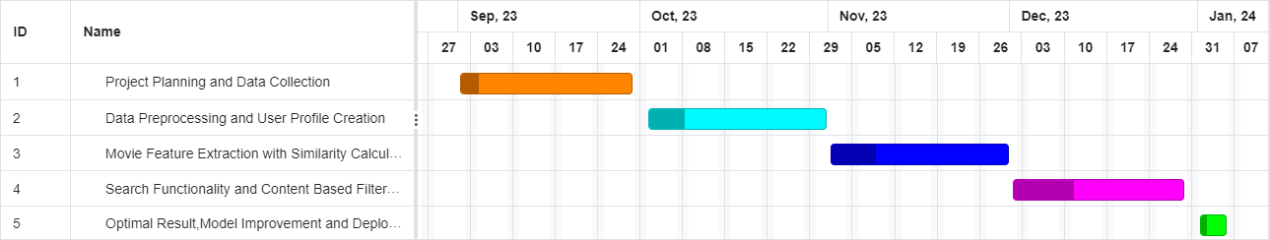
Gantt chart

Slide 14
Future Work Scope
Enhanced Personalization
Integration of Multiple Data Sources
Improved Feature Extraction
Real-Time Updates
Contextual Recommendations

Slide 15
Conclusion
In this project, we trying to improve the accuracy, quality and scalability of movie recommendation system, a Hybrid approach by unifying content based filtering Cosine Similarity is presented in the proposed methodology.

Slide 16
References
[1] Pradeep NK, Rao Mangalore KK, Rajpal B, Prasad N, Shastri R. Content based movie recommendation system. International journal of research in industrial engineering. 2020 Dec 1;9(4):337-48.
[2] K. Sparck Jones. "A statistical interpretation of term specificity and its application in retrieval". Journal of Documentation, 28 (1). 1972.
[3]G. Salton and M. J. McGill. "Introduction to modern information retrieval". 1983

Slide 17


